Slide 1
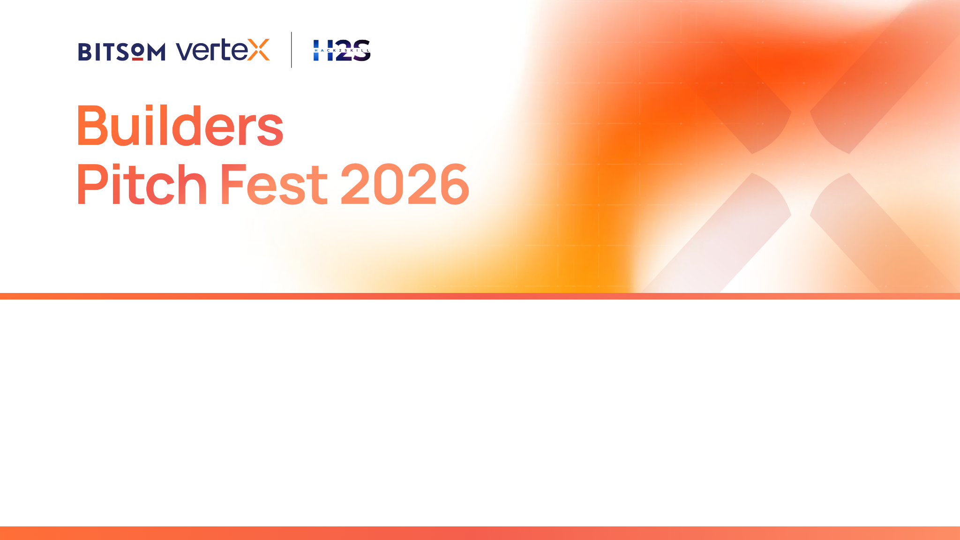

Slide 2

IMPORTANT
This submission deck is designed to help you present your startup in a structured and consistent manner. It enables reviewers to evaluate your solution across product, technology, AI innovation, business viability, customer validation, and enterprise readiness.
Strong submissions will demonstrate:
A clearly validated customer problem and market opportunity
Meaningful and responsible application of AI to solve the problem
Technical depth through a scalable and well-designed architecture
Product maturity supported by customer validation and measurable traction
A sustainable business model with a clear go-to-market strategy
A compelling vision for growth through the BITSoM Vertex incubation programme
Guidelines
This is not a traditional fundraising pitch deck.
Focus on demonstrating the reasoning behind your decisions rather than making marketing claims.
Wherever applicable, support your responses with evidence, metrics, customer insights, product screenshots, architecture diagrams, user journeys, and other relevant visuals.
Not every question may be applicable to every startup. Answer the questions that are most relevant to your solution and provide sufficient context to help reviewers understand your approach.

Slide 3
Startup Snapshot
What problem are you trying to solve
What inspired you to work on this problem?

Slide 4
Problem Understanding
What problem are you solving, and who experiences it most acutely?
What research, observations, or evidence validate this opportunity?

Slide 5
Customer & Opportunity
Who is your ideal customer, and who would make the buying decision?
How large is the opportunity if your assumptions prove correct?

Slide 6
Proposed Solution
What is your proposed solution, and how does it address the identified problem?
What are the key capabilities you envision?
What measurable value do you expect the solution to deliver?

Slide 7
Technology & AI Approach
What role will AI play in your proposed solution, and why is it essential?
What technologies, AI models, or frameworks do you plan to use, and why?
What makes you feel your product is a genuine AI product, and not an AI wrapper?

Slide 8
Competitive Landscape
What alternatives currently exist?
Why do you believe your approach is better suited to solving this problem?

Slide 9
Business Model & Go-To-Market
Who do you expect will pay for your solution?
How do you plan to acquire your first customers?

Slide 10
Development Roadmap
What are the next major milestones toward building your MVP?
What resources or support will be most critical during this journey?

Slide 11
Team
Why is your team uniquely positioned to solve this problem?
What relevant domain or technical expertise does the team possess?

Slide 12
Why BITSoM Vertex?
Why have you applied to the BITSoM Vertex programme?
What is the biggest challenge preventing you from building your MVP?

Slide 13
Supporting Material
Provide links to your:
Prototype (if available)
Demo Video (if available)
GitHub Repository (if available)
Website / Landing Page (if available)
Contact Details

Slide 14


